Slide 1


Predicting Bank Failures: An Exploratory Analysis
A study based on financial indicators of historically failed banks.
Notes:
Welcome to the presentation on Predicting Bank Failures. Today, I'll delve into historical financial data to uncover potential warning signs of bank instability.

Slide 2
Business Problem & Background
Objective: Identify financial "red flags."
Use of historical data of failed banks.
Patterns preceding failure as indicators.
Notes:
Using historical data, my primary aim is to pinpoint financial indicators that might suggest a bank's risk of failing in the near future.

Slide 3
Data Explanation & Methods
Dataset: Failed banks' financials.
EDA to highlight patterns.
Visualizations of key financial indicators.
Notes:
The dataset, derived from failed banks, underwent cleaning processes. Using EDA, I visualized key metrics to uncover patterns.

Slide 4
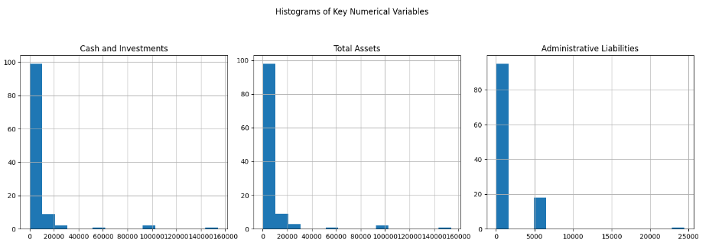
Visualization - Distribution of Key Metrics
Consistent low assets across most failed banks
Variability among banks.
Potential outliers as red flags.
Low administration may point towards downsizing before failure
Notes:
In observing key metrics we find that for most failed banks, just before failure they showed a decrease in assets and also a low amount of administrative liabilities which may speak to a level of downsizing before a failure.

Slide 5
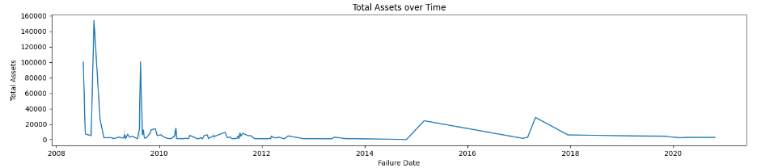
Held assets over the last fifteen years
Failure from high assets occurred during the 2008 financial crisis but since then failure has been less of a “shock” as it occurs to banks already low on assets.
Notes:
When looking at failed assets held across bank failures over time, we see significant spikes before 2010 which indicates that some banks failed around the time of the 2008 financial crisis despite having considerable assets and were more of a “shock” that they failed. Since 2010, most failed banks have had predictably low assets before going into receivership.

Slide 6
Analysis
Identified correlations between variables.
01
Patterns spotlighted as potential red flags.
02
Financial health indicators analyzed.
03
Notes:
The analysis revealed patterns and correlations which might indicate potential financial distress or impending failure

Slide 7
Conclusion & Recommendations
Patterns provide initial insights.
Validation is crucial before application.
Red flags to be applied judiciously.
Understanding the goal of modeling, intervening in potential failures before its too late.
Classification models following patterns of assets, cash, and administrative costs.
Notes:
While initial patterns are identified, it is important to validate these patterns across all data possible. Models can be created that focus on specific red flag metrics such as total assets or administrative costs to apply red flags to financial institutions given their live data. These red flags do not indicate necessary failure, but provide a framework for investigation and intervention when necessary.

Slide 8
Assumptions, Limitations & Challenges
Historical patterns as future failure indicators.
Limited by absence of non-failure data.
Validation and reliability remain challenges
Notes:
While historical patterns guide this study, the absence of non-failure data presents limitations. Furthermore, validating and ensuring reliability remain challenges."

Slide 9

References
Failed Banks Data with Balance Sheet. (2023, May 15). Kaggle.
https://www.kaggle.com/datasets/utkarshx27/failed-banks-database/data

Slide 10

Thank You & Questions
Notes:
Thank you for your attention. I'm now open to any questions or further discussions.

